Slide 1
UAS BLOCKCHAIN
Arasy Bazwir (1103183236)
Alifia Fairuz Z (1103184193)
Ryndam Putra A (1103184020)
Fajri Nurfauzan (1103180184)

Slide 2

What is Blockchain
A blockchain is a distributed database or ledger that is shared among the nodes of a computer network. As a database, a blockchain stores information electronically in digital format. Blockchains are best known for their crucial role in cryptocurrency systems, such as Bitcoin, for maintaining a secure and decentralized record of transactions. The innovation with a blockchain is that it guarantees the fidelity and security of a record of data and generates trust without the need for a trusted third party.

Slide 3

What is Remix IDE
Remix IDE is an open source web and desktop application. It fosters a fast development cycle and has a rich set of plugins with intuitive GUIs. Remix is used for the entire journey of contract development with Solidity language as well as a playground for learning and teaching Ethereum.

Slide 4
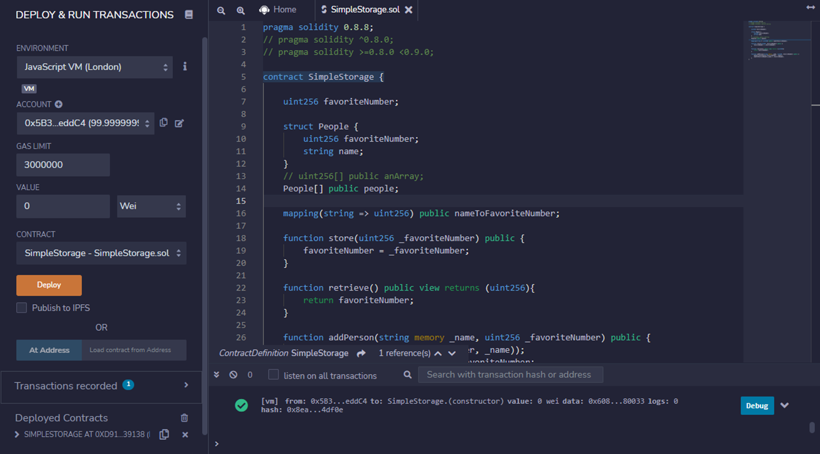
Remix Simple Storage (Example)
Description: This is a preview of Contract Remix Simple Storage, which uses the VM JavaScript Environment (London).

Slide 5
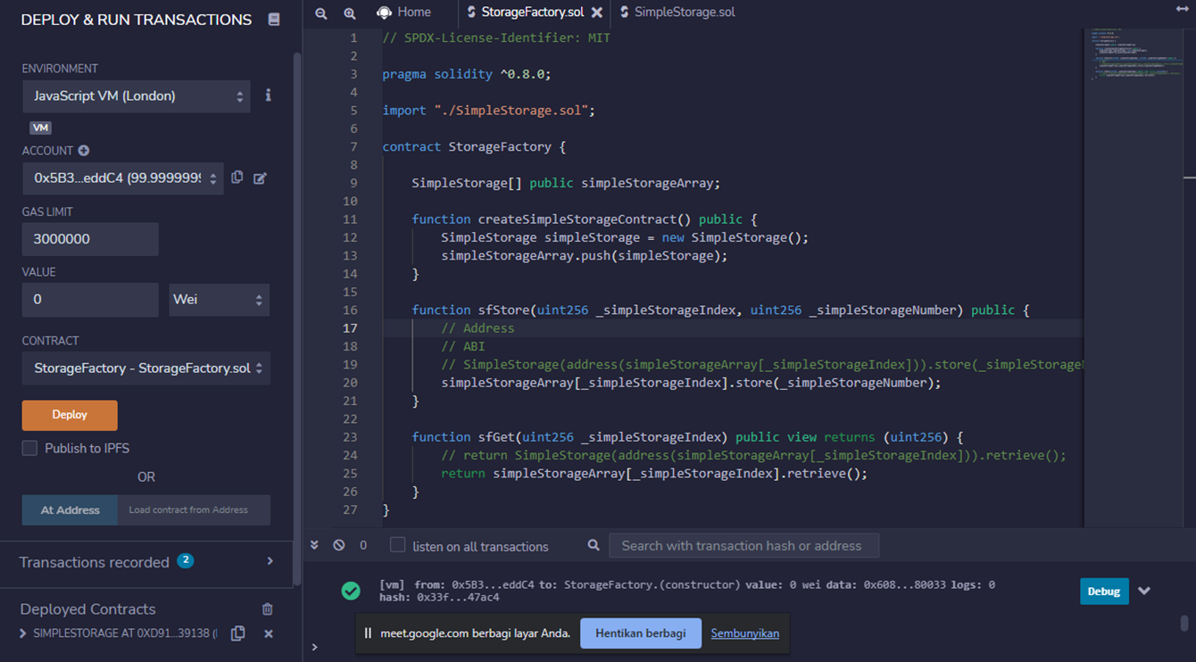
Remix Storage Factory
Description: This is a preview of Contract Remix Storage Factory, which uses the VM JavaScript Environment (London).

Slide 6
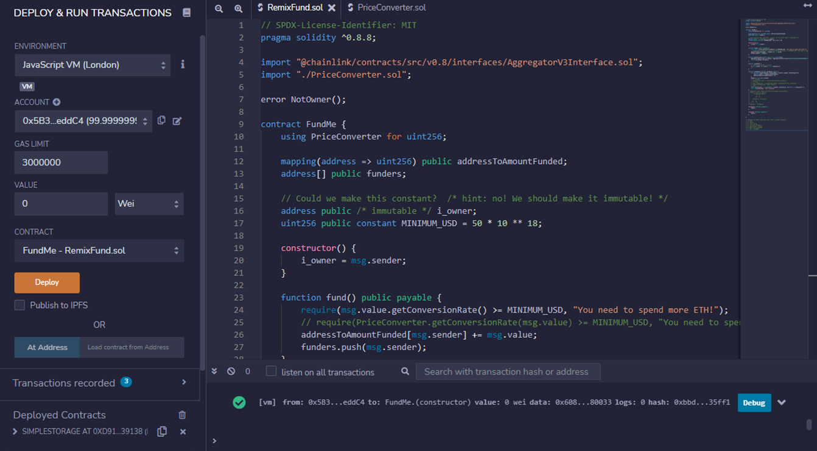
Remix Fund Me
Description: This is a preview of Contract Remix Fund ME, which uses the VM JavaScript Environment (London).

Slide 7
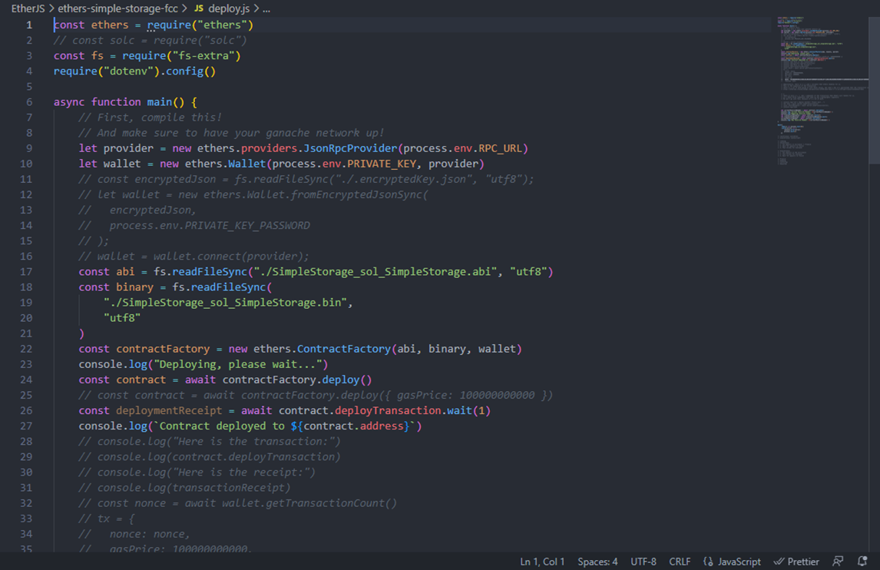
Deploy Ether.js
Description: This is a preview of the Ether.js code Deployment.

Slide 8
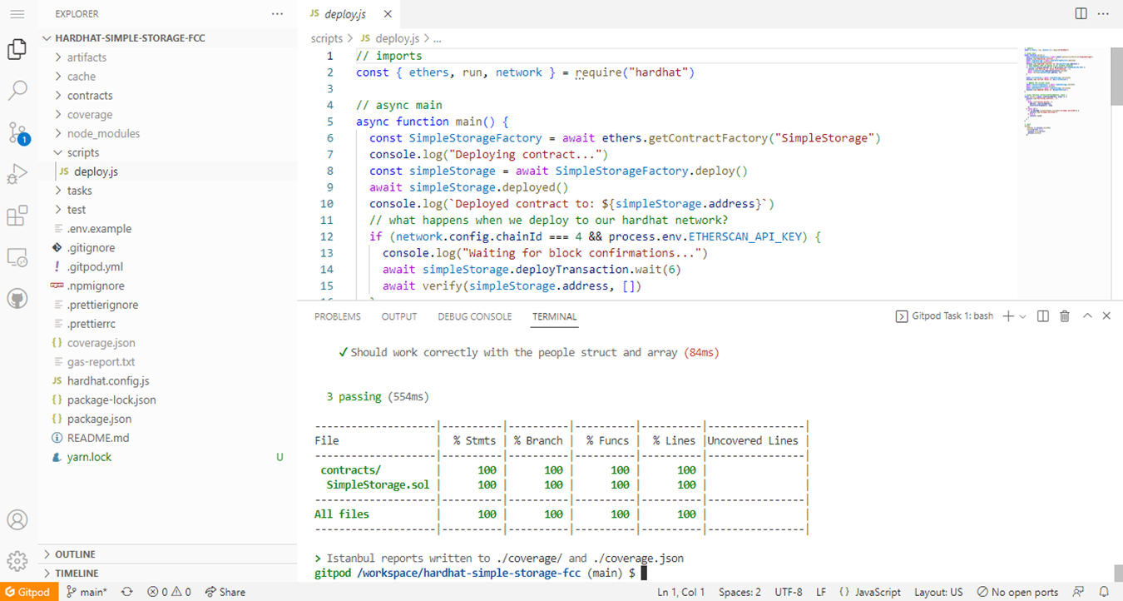
Hard hat Simple Storage
Description: This is a preview of Scripts Hard Hat Simple Storage, for the development on the Gitpod Platform.

Slide 9
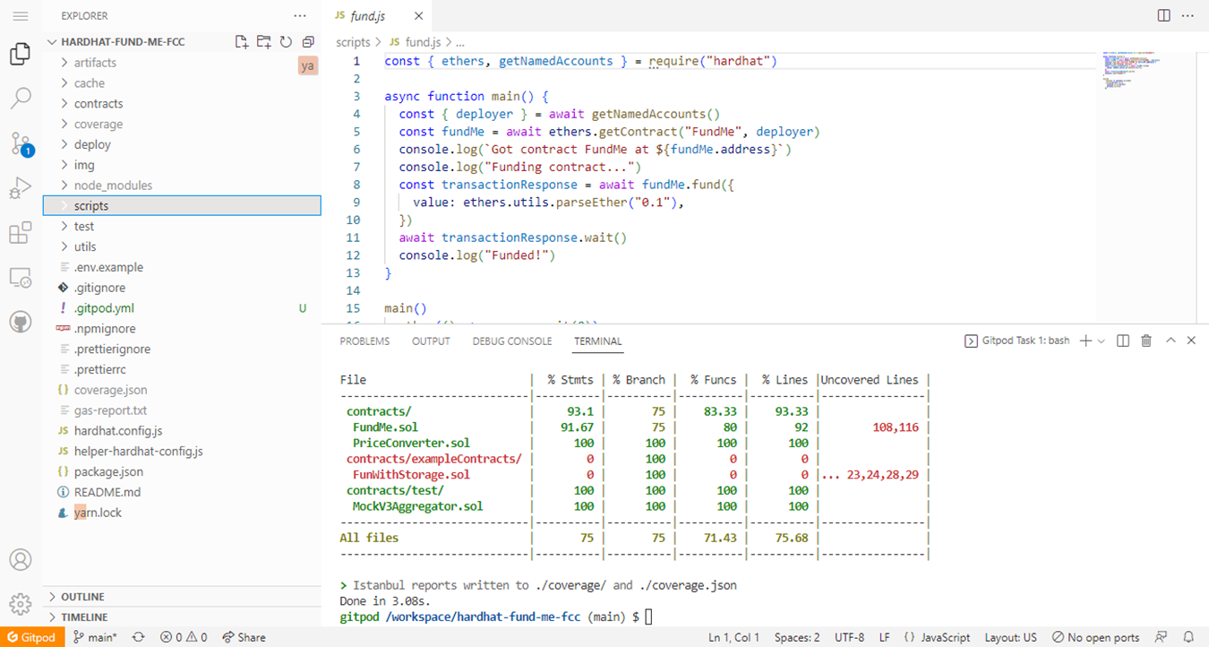
Hard hat Fund Me
Description: This is a preview of Scripts Hard Hat Fund Me for the development on the Gitpod Platform.

Slide 10
Front end Fund Me (Example)
Description: This is a preview of Fund Me Front end showing menu, Connect, Get Balance, Withdraw, and searching ETH Amount.

Slide 11
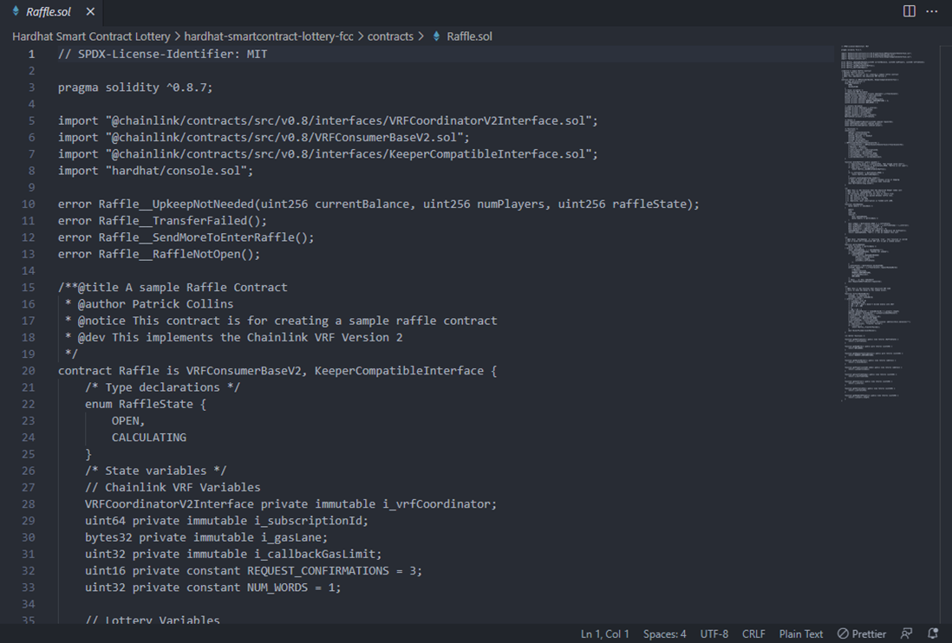
Hardhat Smart Contract Lottery
Description: This is a preview of the Hardhat Smart Contract Lottery scripts.

